Slide 1

Principles of Mobile App Design
IT 367
Jianwei Lai
TikTok hit with record fine for collecting data on children
$5.7 million
Notes:
https://www.cnn.com/2019/02/28/tech/tiktok-ftc-fine-children/index.html

Slide 2
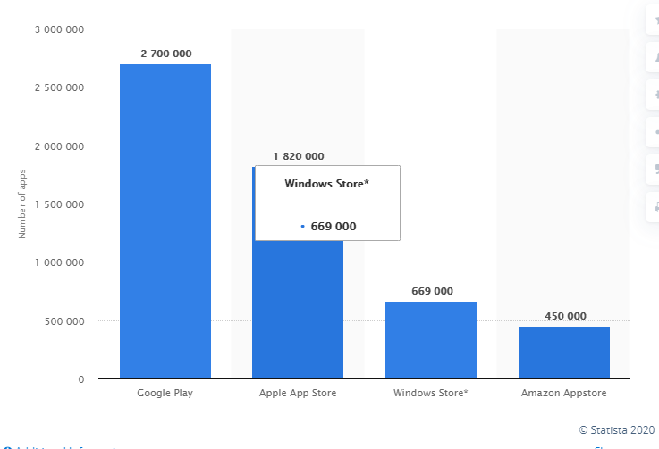
Number of apps available in leading app stores as of 2nd quarter 2020
Notes:
https://www.statista.com/statistics/276623/number-of-apps-available-in-leading-app-stores/

Slide 3
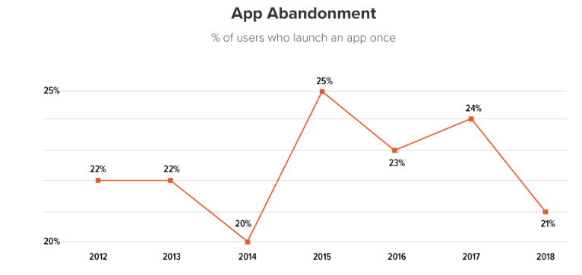
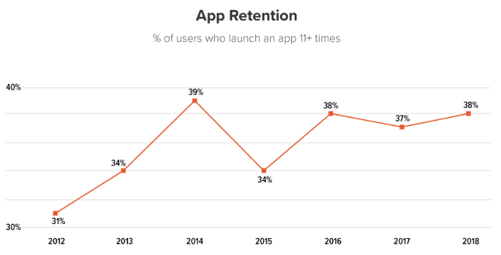
Challenges
It’s become tougher for companies/developers to get people to find and download their apps
More than ever, people are engaging with their phones in crucial moments and for shorter periods of time
Their experiences need to be efficient and delightful
Notes:
As many as 21% of app users open an app once and never return

Slide 4
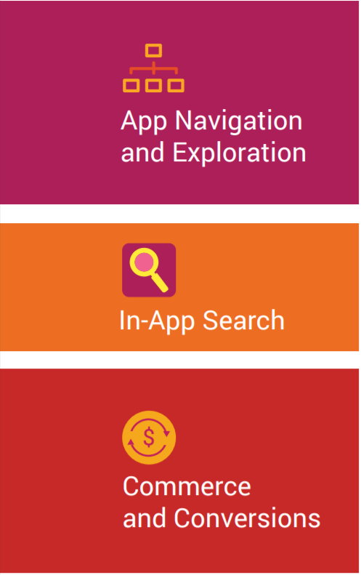
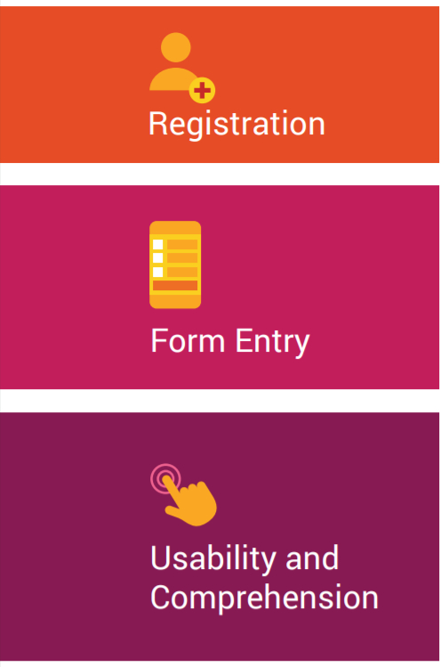
Principles for Mobile App Design
A user study conducted by Google and AnswerLab
more than 100 people
100 different apps
across a variety of domains
e-commerce
insurance
travel
food ordering
ticket sales and services, and
financial management

Slide 5
Principle 1-4

Slide 6
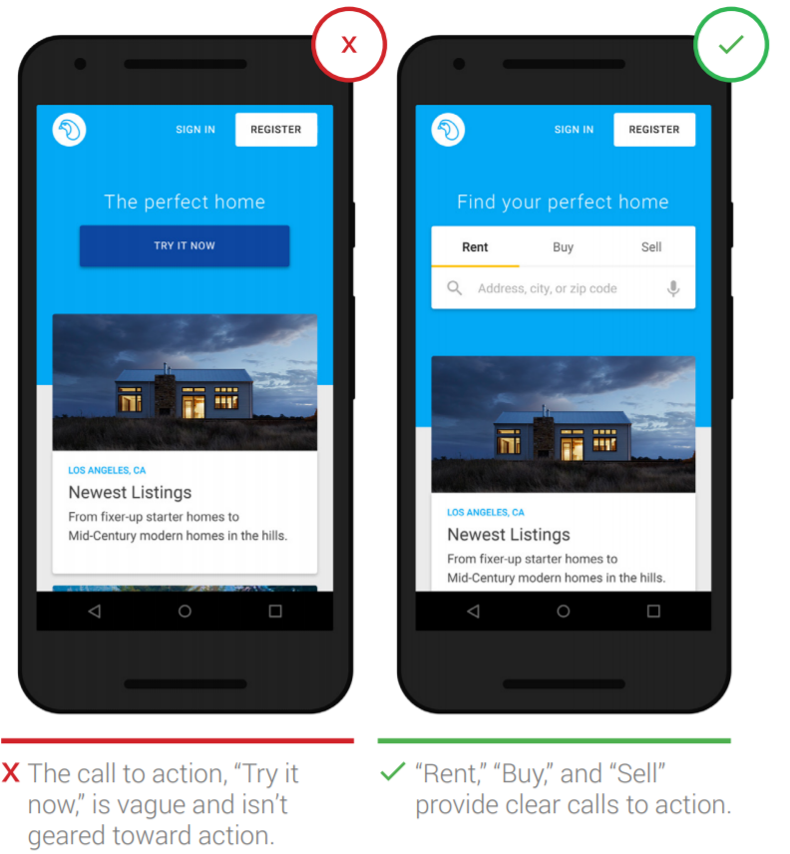
Principle 1: Show the value of your app upfront
Engage users by addressing their tasks clearly, placing calls to action up front and center

Slide 7
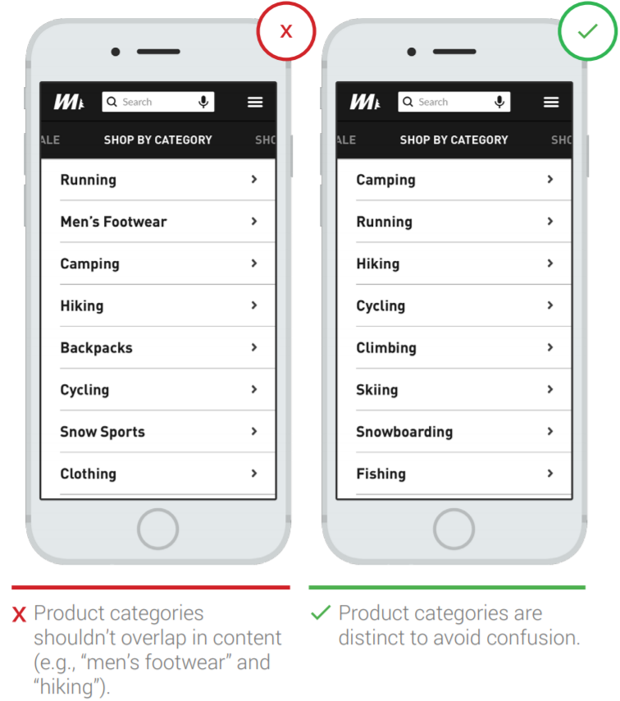
Principle 2: User-friendly menu categories
Users struggle to interpret and distinguish menu categories that do not align with their mental models for categories
Menu categories should be clear with no overlap

Slide 8
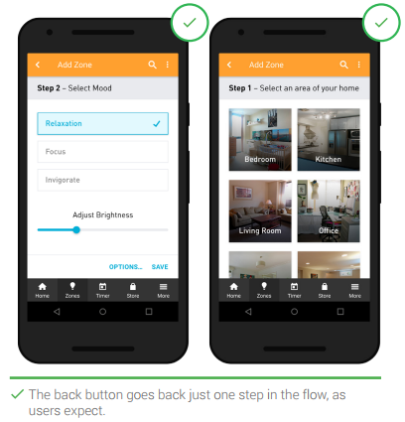
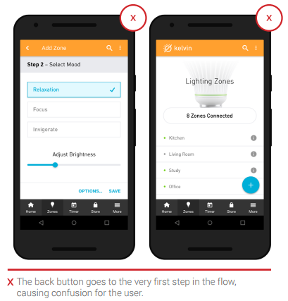
Principle 3: Allow users to “go back” easily in one step
Users may only want to go back one step as they use the app.
Apps should leverage back functionality so that users don’t feel forced to have to start over from the home screen, which, in some cases, results in losing any unsaved data.

Slide 9
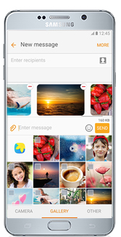
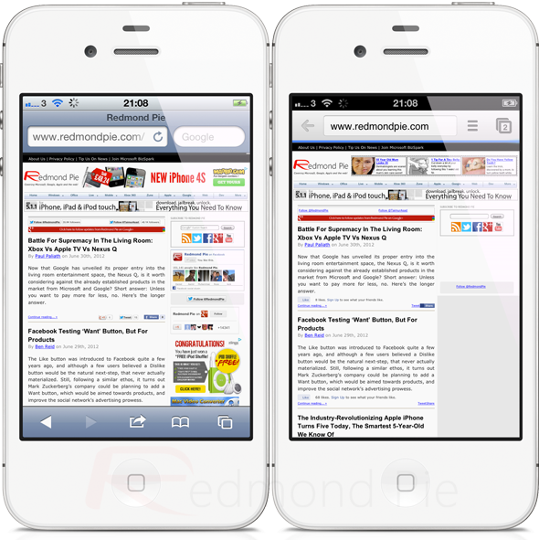
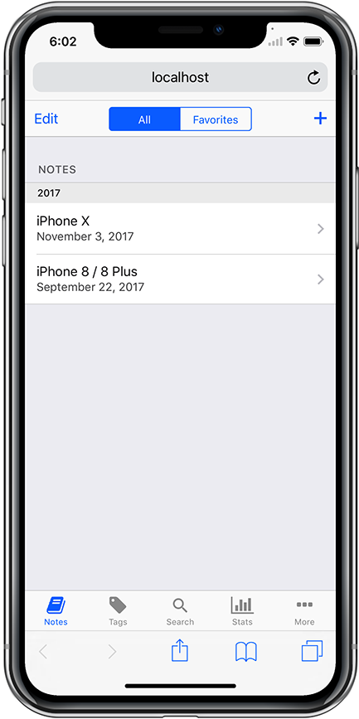
Ways to “go back”

Slide 10
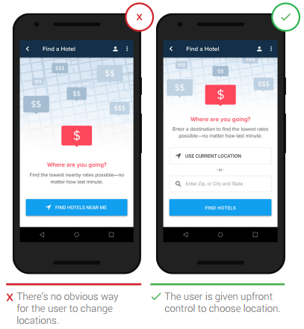
Principle 4: Make it easy to manually change location
Auto-detection of location can save users’ time.
However, there are times when users need to find a store that’s not located nearby.
Make manual entry of location easy and straightforward.

Slide 11
Principle 5-7

Slide 12
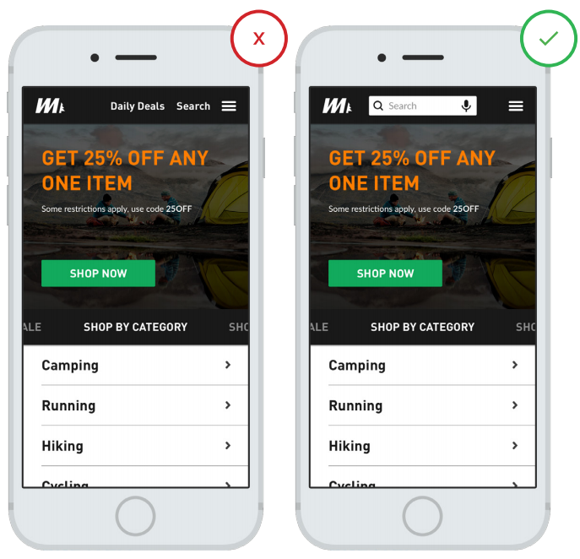
Principle 5: Prominently display the search field

Slide 13

If searching is an essential function, is the following a good design?
It’s important to display full open-text field, because search hidden behind in icon makes search feature less noticeable and increases the cost of interaction.
Notes:
https://uxplanet.org/design-a-perfect-search-box-b6baaf9599c

Slide 14
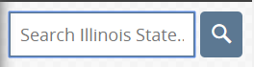

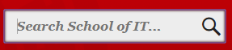
Which design is better?
A button helps people recognize that there’s an additional step to trigger the search action — even if they decide to do this by pressing Enter.
Notes:
https://uxplanet.org/design-a-perfect-search-box-b6baaf9599c

Slide 15
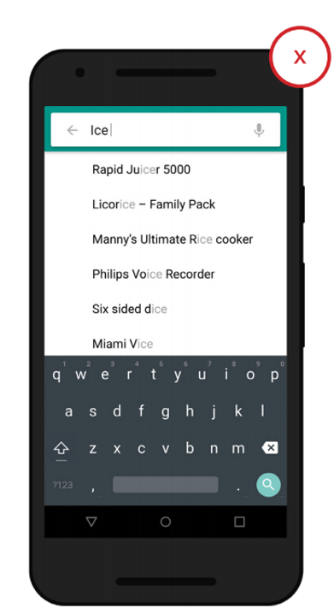
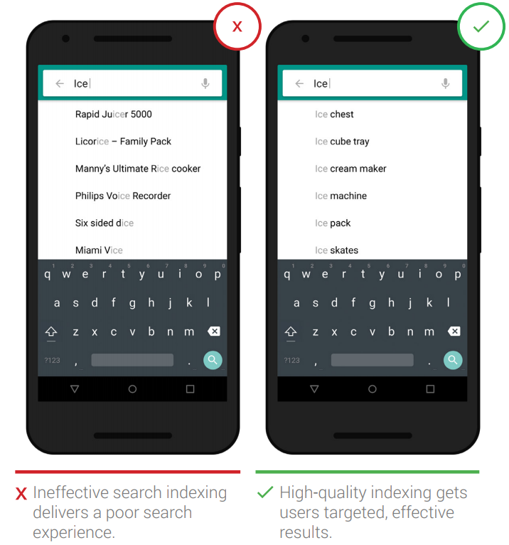
Principle 6: Use effective search indexing
Some helpful functions include
spelling auto-corrections,
recognition of root words,
predictive text, and
suggestions while the user enters text.
Which heuristic is it related to?
Recognition rather than recall
Notes:
Recognition rather than recall

Slide 16
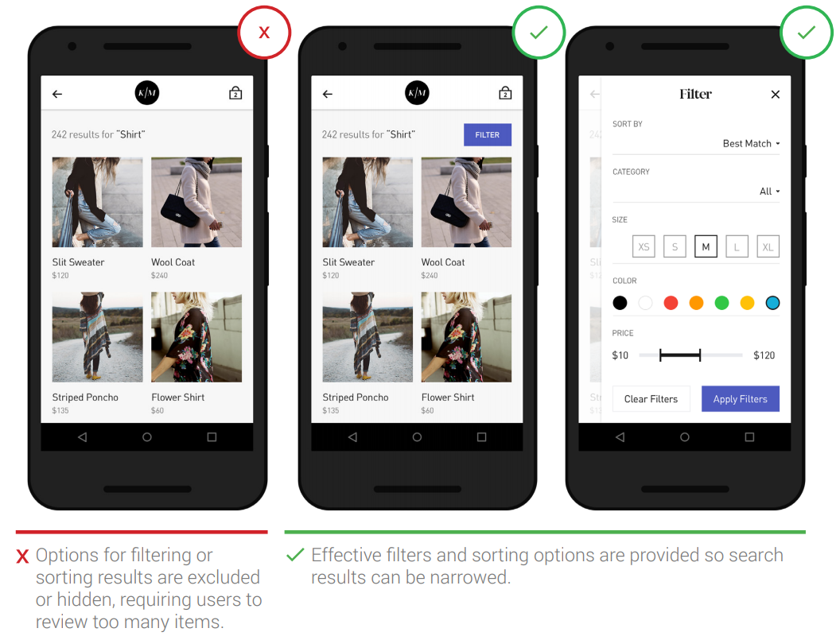
Principle 7: Provide filter and sort options
Users become overwhelmed when their search terms result in seemingly irrelevant and/or too many results
Filter and sort options can help users narrow and organize their results

Slide 17
Principle 8-10

Slide 18
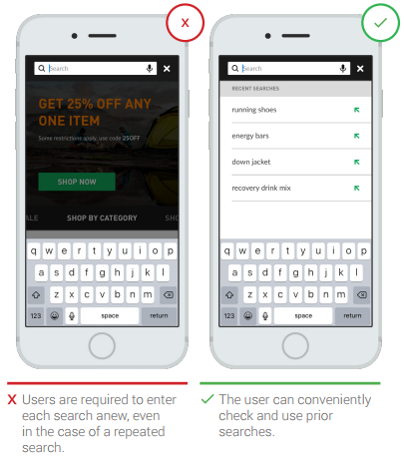
Principe 8: Provide previous search and purchase information
Save the user time and effort by making previous searches and recent purchases readily available
This is particularly important in frequently used apps where users conduct repeat searches or purchases

Slide 19
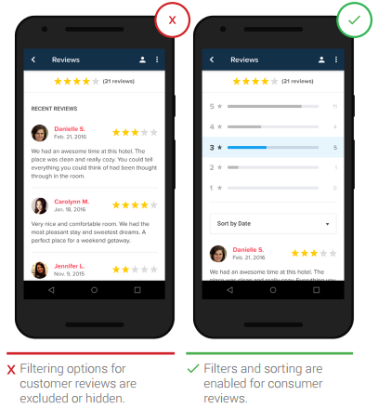
Principle 9: Allow user reviews to be viewed and filtered
Aggregate rating distributions and allow users to sort and filter so they can get the “real story” about an item
Let them browse the most recent, the most positive, and the most negative reviews to discover any common themes

Slide 20
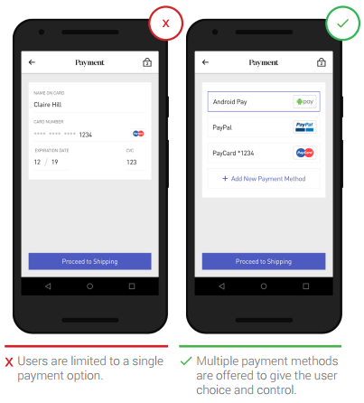
Principle 10: Provide multiple third-party payment options
Apps that provide these payment options, such as PayPal, Apple Pay, and AndroidPay
relieve users from the pain point of filling out additional forms during checkout
can provide an increased sense of security

Slide 21
Principle 11-12

Slide 22
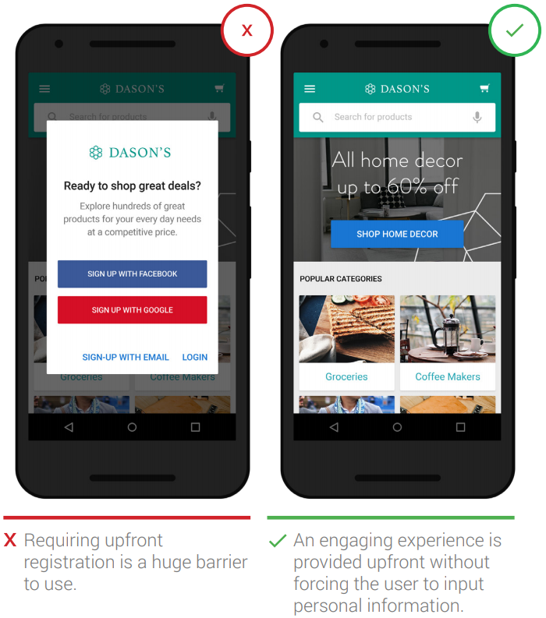
Principle 11: Provide clear utility before asking users to register
Users will abandon an app that asks them to provide personal information upfront unless there’s some form of immediate payoff (ordering a car service or food delivery, for example).

Slide 23
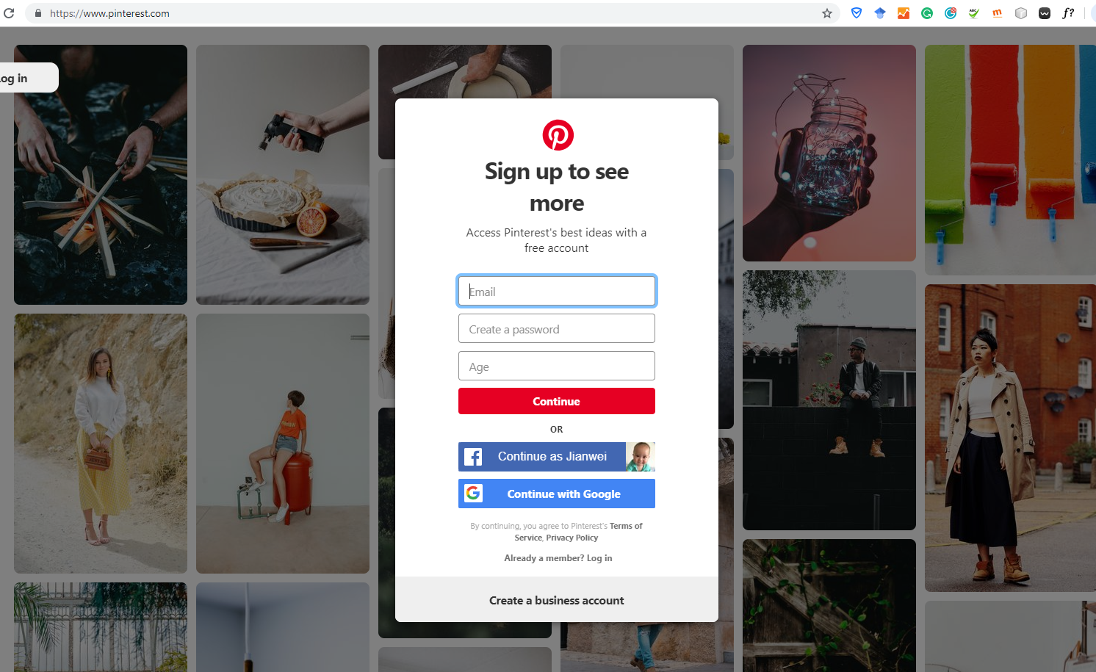
https://www.pinterest.com/

Slide 24
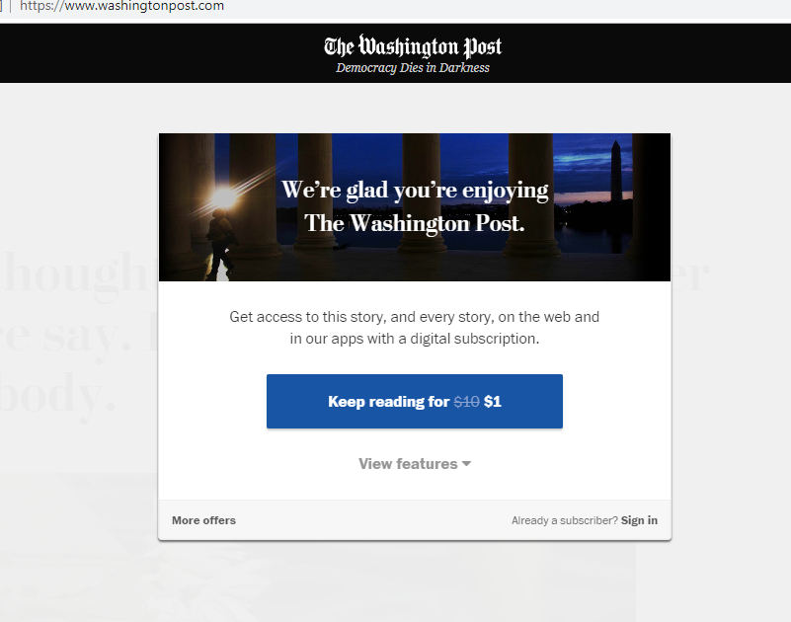
https://www.washingtonpost.com/

Slide 25
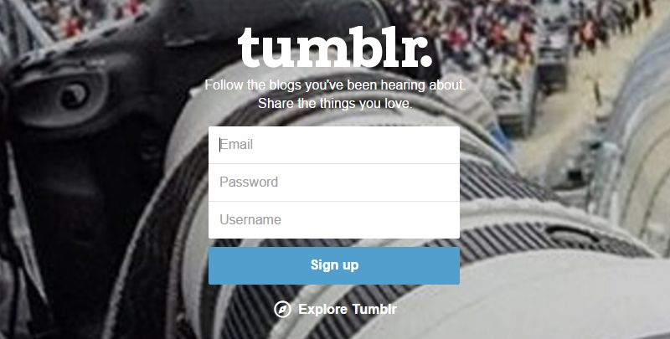
Tumblr Sing up form
Any thing can be improved?
Notes:
http://www.uxforthemasses.com/sign-up/
Color contract
Show/hide password
Thrid party signin

Slide 26
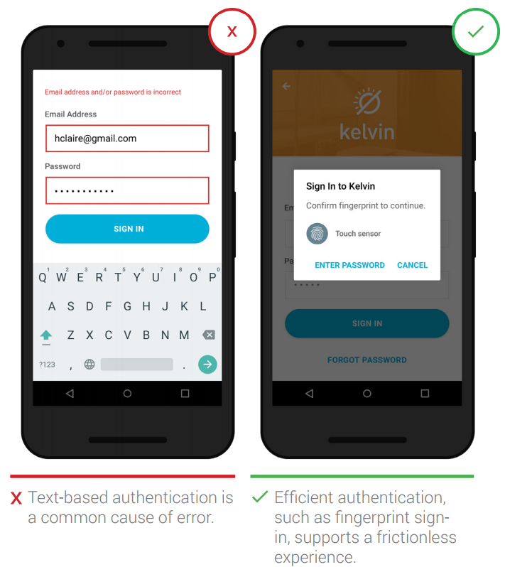
Principle 12: Make password authentication a frictionless experience
Users get annoyed when they have to go through an arduous, multi-step task to set up or reset a password
Reduce the risk of abandonment by simplifying the authentication experience
Minimize the number of steps required or use different authentication methods such as a third-party login or fingerprint touch login
Notes:
Regarding biomectric signin, there is a study showing that scientists can get your fingerprints by analyzing your social media pictures

Slide 27
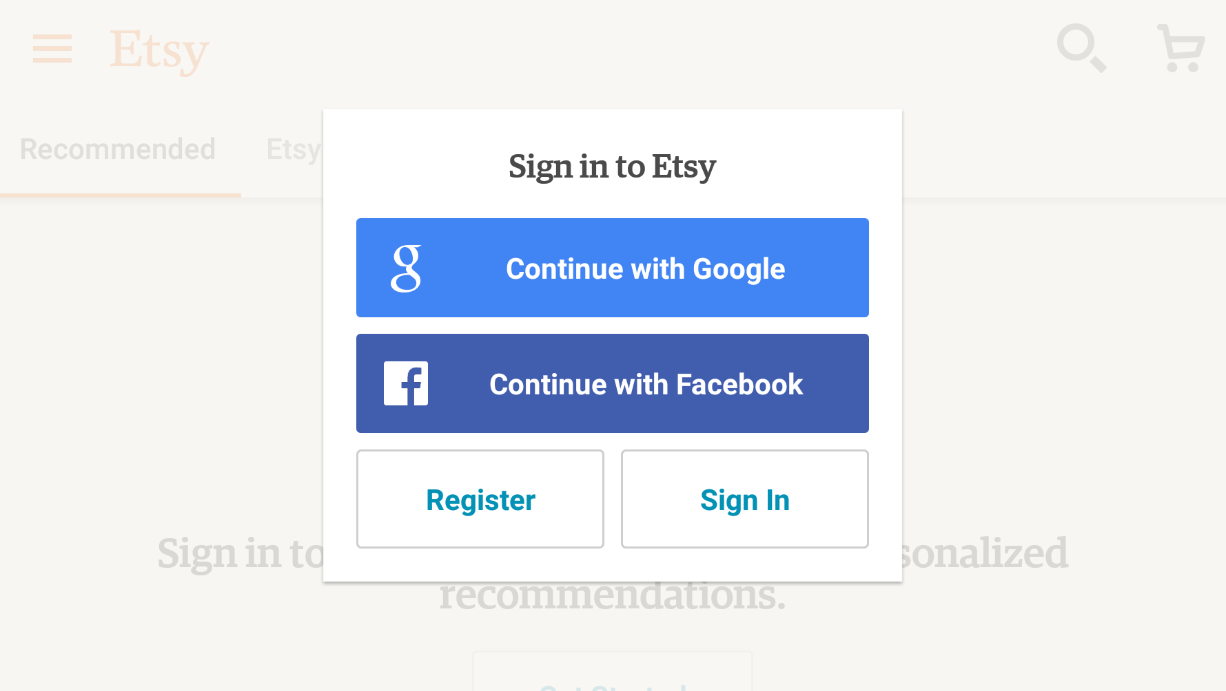

Slide 28
Principle 13-15

Slide 29
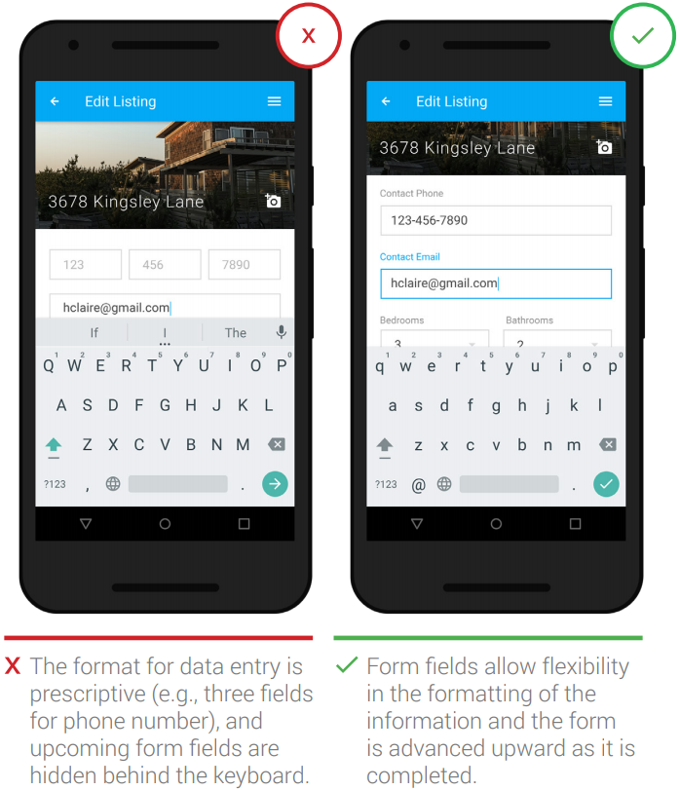
Principle 13: Build user-friendly forms
Design screens that can interpret multiple input formats rather than make the user adapt to the app’s limitations
Ensure that form fields are not obstructed from view by interface elements such as the keyboard

Slide 30
How to deal with different formats?
410-334-1111
(410)-334-1111
4103341111

Slide 31
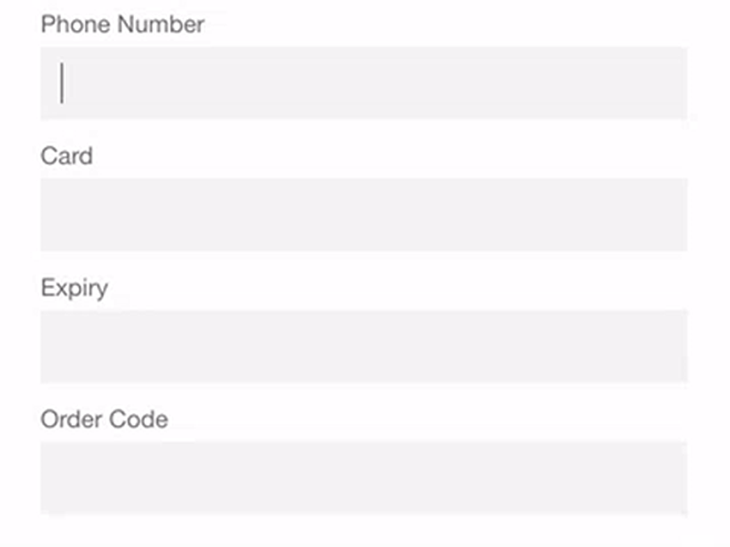

Slide 32
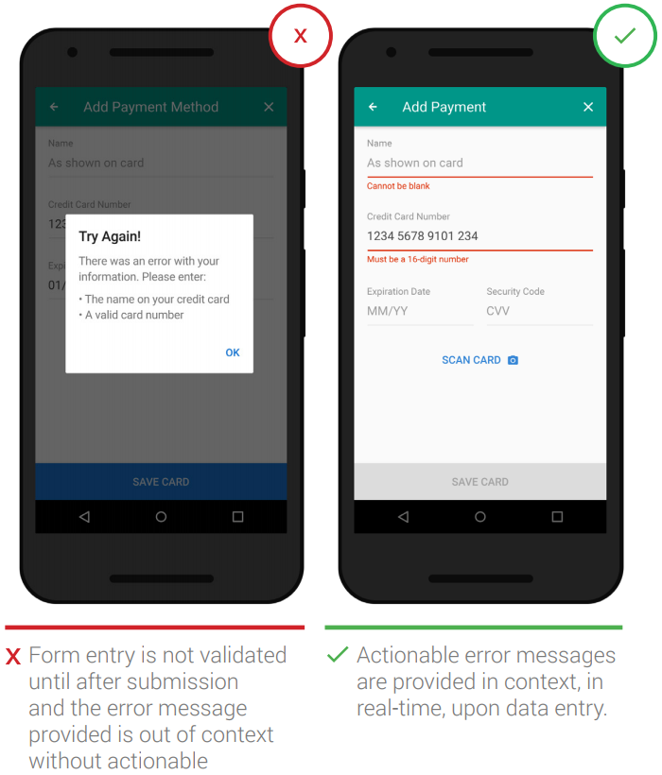
Principle 14: Communicate form errors in real time
Users dislike when they go through the process of filling out a form only to find out at submission, that they’ve made an error
Provide real-time error information to alleviate this pain point and continuously clarify to the user when an area of a form is successfully completed or validated

Slide 33
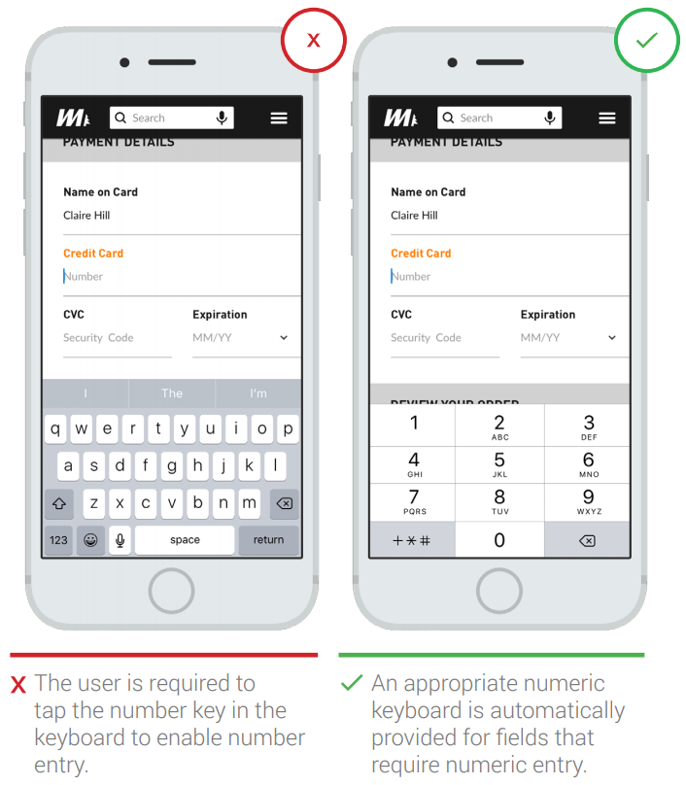
Principle 15: Match the keyboard with the required text inputs
Provide an appropriate keyboard for text entry

Slide 34
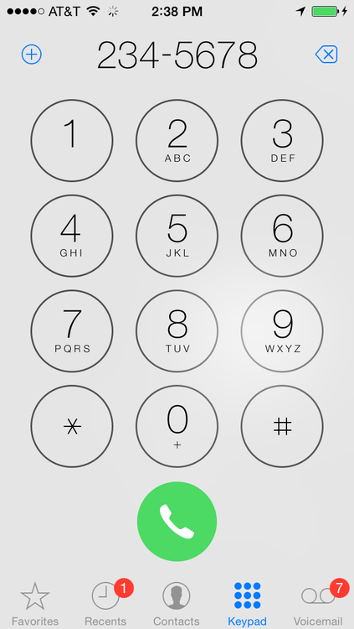
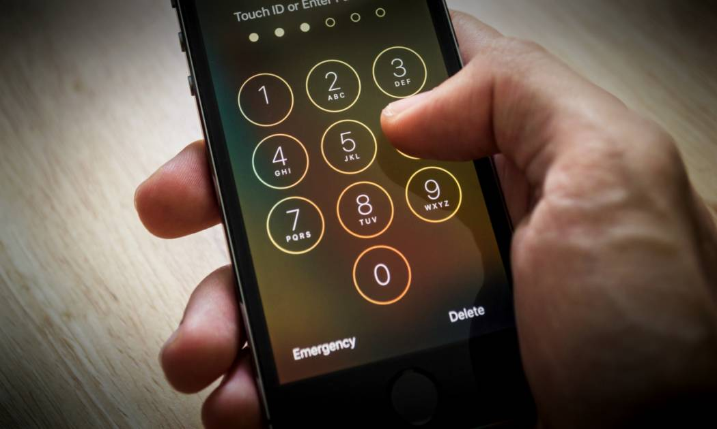
Existing examples
Then why include the letters?

Slide 35
Principle 16-19

Slide 36
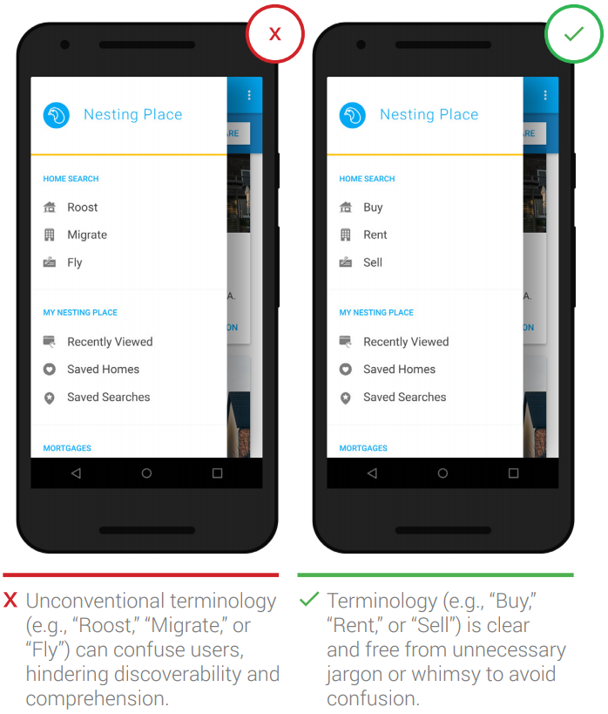
Principle 16: Speak the same language as your users
Unknown terms or phrases will increase cognitive load for the user

Slide 37

http://itk.ilstu.edu/support/msdnaa.php

Slide 38
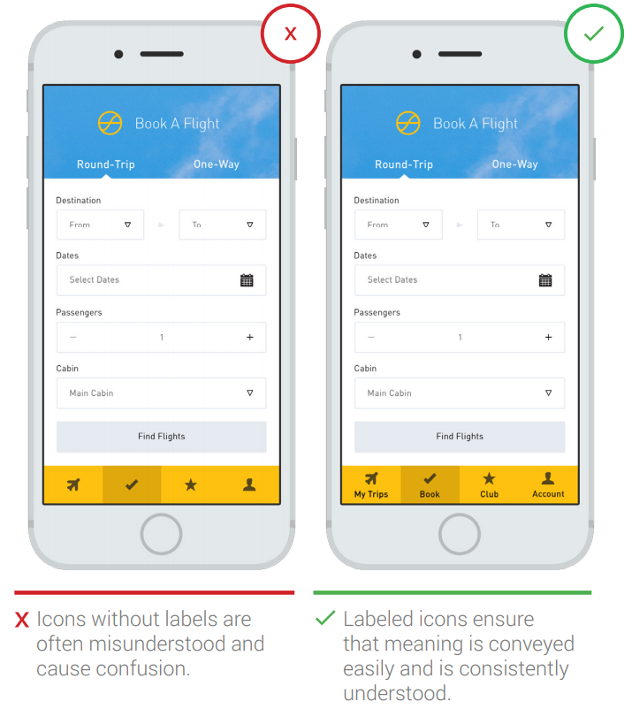
Principle 17: Provide text labels and visual keys to clarify visual information
Visuals and iconography need text labels for consistent and proper interpretation

Slide 39
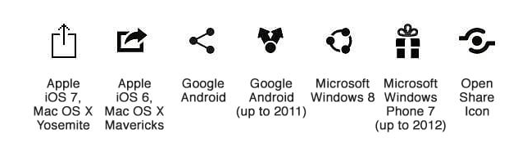
The Share Icon
What are the meanings of those icons?
https://blog.placeit.net/confusing-icons-history/
Notes:
https://blog.placeit.net/confusing-icons-history/

Slide 40
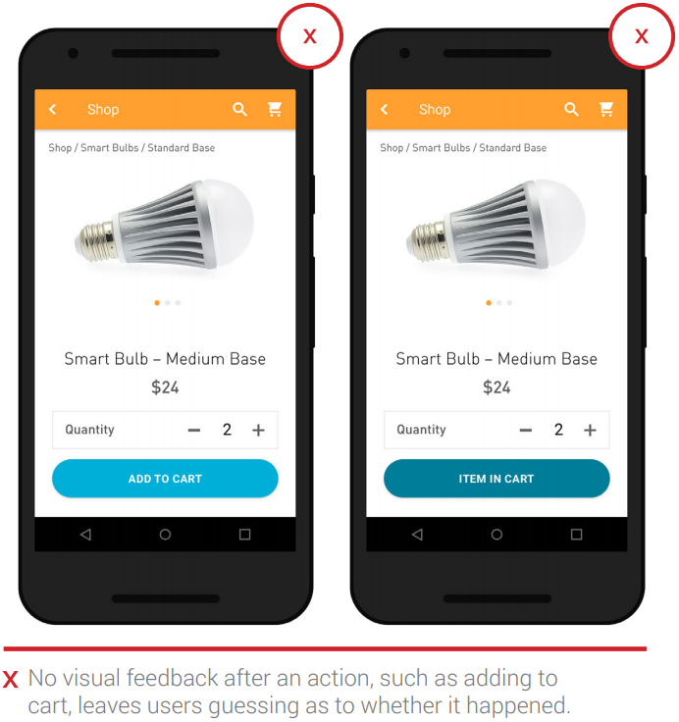
Principle 18: Be responsive with visual feedback after significant actions
When users add an item to the cart or submit an order, lack of feedback can cause them to question whether the action has been processed
Apps that provide a visual animation or another type of visual cues eliminate this guesswork for the user

Slide 41
Create your own design
Provide visual feedback that 2 items have been added to the shopping cart
What if the items were added by accidently?

Slide 42
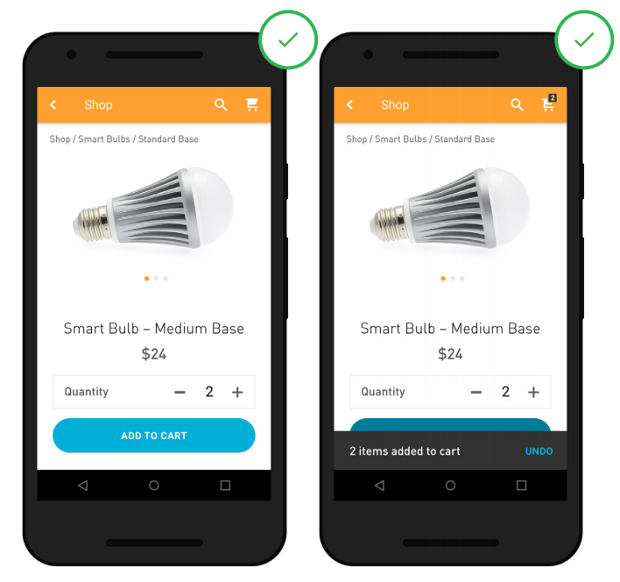
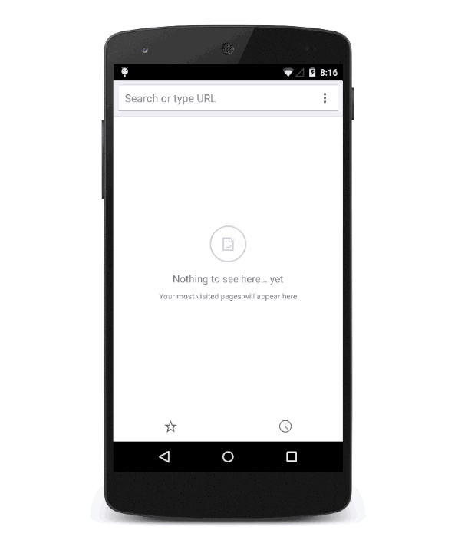

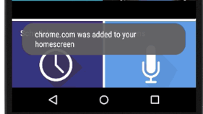
Feedback with “Snackbar”/ "Toast"
Which heuristic is “UNDO” related to?
Snackbar
Toast
Notes:
User control and freedom
They automatically disappear after a timeout or after user interaction elsewhere on the screen, particularly after interactions that summon a new surface or activity. Snackbars can be swiped off screen.

Slide 43
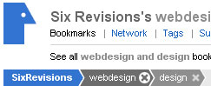

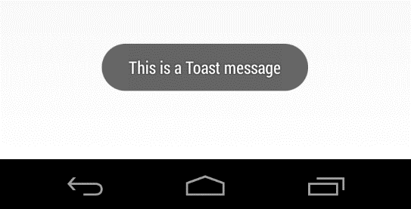
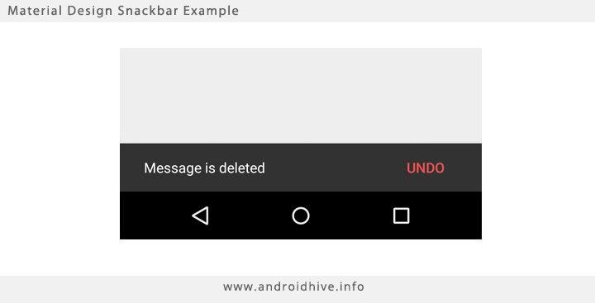

Some UI Components with “food” names
Hamburger menu
Toast
Snackbar
Breadcrumb
The term comes from the Hansel and Gretel fairy tale in which the two children drop breadcrumbs to form a trail back to their home.

Slide 44
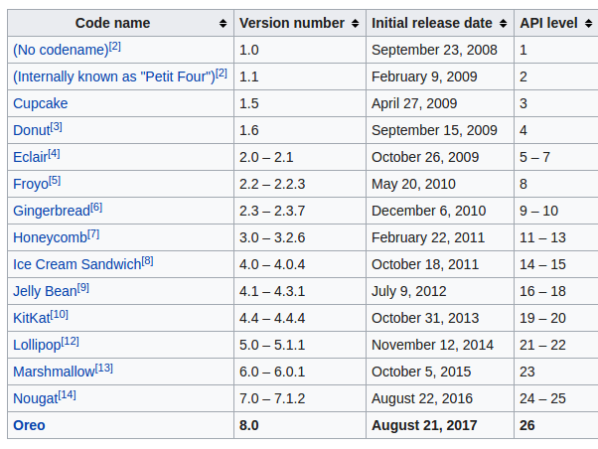
Android APIs with “snack” names

Slide 45
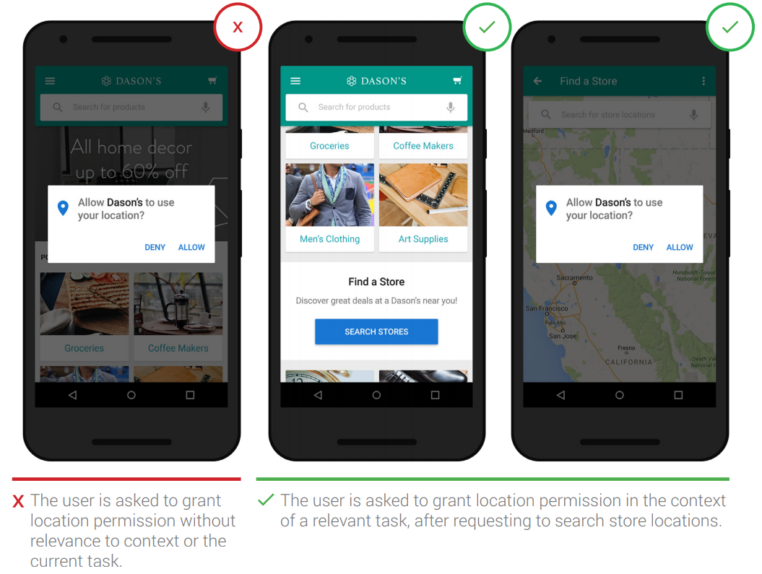
Principle 19: Ask for permissions in-context
Apps should ask for permissions in context and communicate the value the access will provide
Users are more likely to grant permission if asked during a relevant task

Slide 46
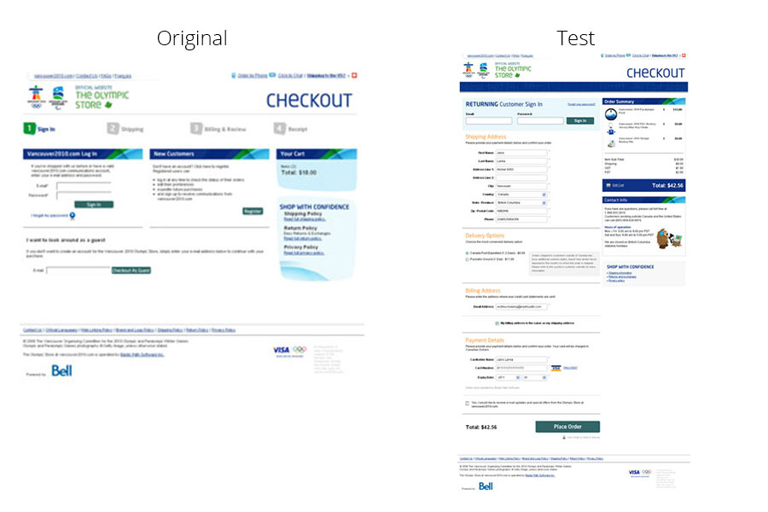
Removing a barrier increased completed purchases by 21.8%.
Notes:
They let their customers check out without the sign-up, moving the extra step of creating an account to the end of the process, after the check out.

Slide 47
6 more principles you need to read by yourself
Create frictionless transitions between mobile apps and the mobile web
Enable comparison shopping features
Make it easy to add and manage payment methods
Differentiate “sign in” from “sign up”
Provide helpful information in context in forms.
Let the user control the level of zoom
Here is the report to read:
https://www.thinkwithgoogle.com/marketing-resources/experience-design/chapter-1-app-navigation-and-exploration/

Slide 48
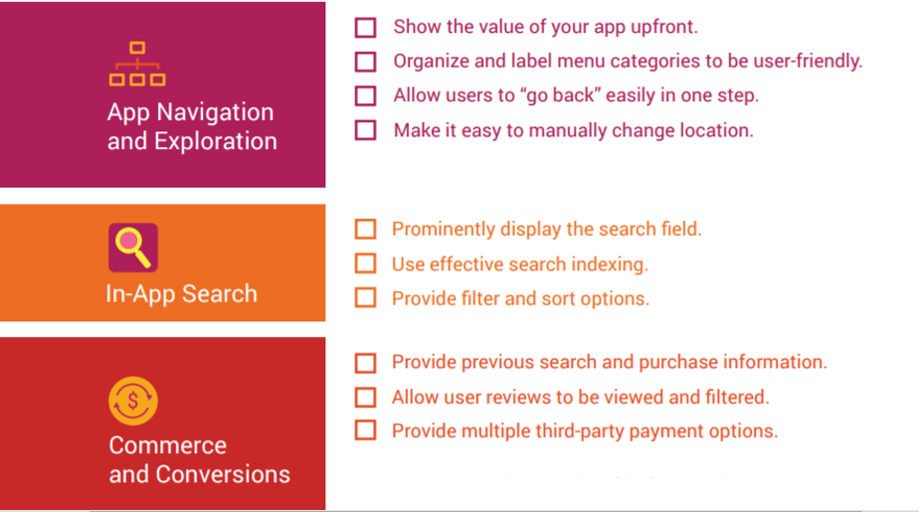
Summary: Principles of Mobile App Design Checklist

Slide 49
